Slide 1

EDUGRAM
Igniting Minds

Slide 2
PROBLEM STATEMENT
Transforming learning into amazing e-learning experiences using modern technology.
The education sector is facing a lot of problems, especially due to the lockdown imposed by the pandemic and an effective solution for this has become absolutely crucial.

Slide 3
SOLUTION
We have created an app that provides the faculty with all the resources required to take classes for the students and monitor their learning that at the same time also provides the students with interactive and easy to access courses thus improving their e-learning experience.

Slide 4
What Is EDUGRAM?
The lockdown due to the COVID-19 pandemic has affected the education sector more so than any others, since most educational institutions have not relied entirely on e-learning services before to take classes, creating unforeseen difficulties. EDUGRAM is the solution to all these problems.
It is a one-stop educational app that provides you with all the necessary e-learning tools.
A user-friendly app with multiple features like online attendance, class management, homework submission, performance reports, extra courses, reference material and much more managed in the most efficient and transparent manner.
It’s a perfect amalgamation of simple user interface design and exciting features.

Slide 5
Features We Provide
Online attendance marking portal
Regular performance reports so that guardians can track their wards’ progress
A course page for each course where the faculty can upload new videos, assignments to be submitted and reference materials and students can access them
Extra credits earned by the students can be later used to avail other paid courses from prestigious institutions
Faculty can set time deadlines for the videos to be watched and assignments to be submitted, which if not completed in time, will cut off access to all the recreational apps in the mobile immediately

Slide 6
TECHNOLOGIES USED
Flutter Flutter SDK is Google's UI toolkit for crafting beautiful, natively compiled applications for mobile, web, and desktop from a single codebase.
Android Studio Android Studio is the official integrated development environment for Google's Android operating system, built on JetBrains' IntelliJ IDEA software and designed specifically for Android development.provides the fastest tools for building apps on every type of Android device.

Slide 7
DEMONSTRATION
The following screenshots offer a demonstration of how EDUGRAM looks once installed on your device.

Slide 8
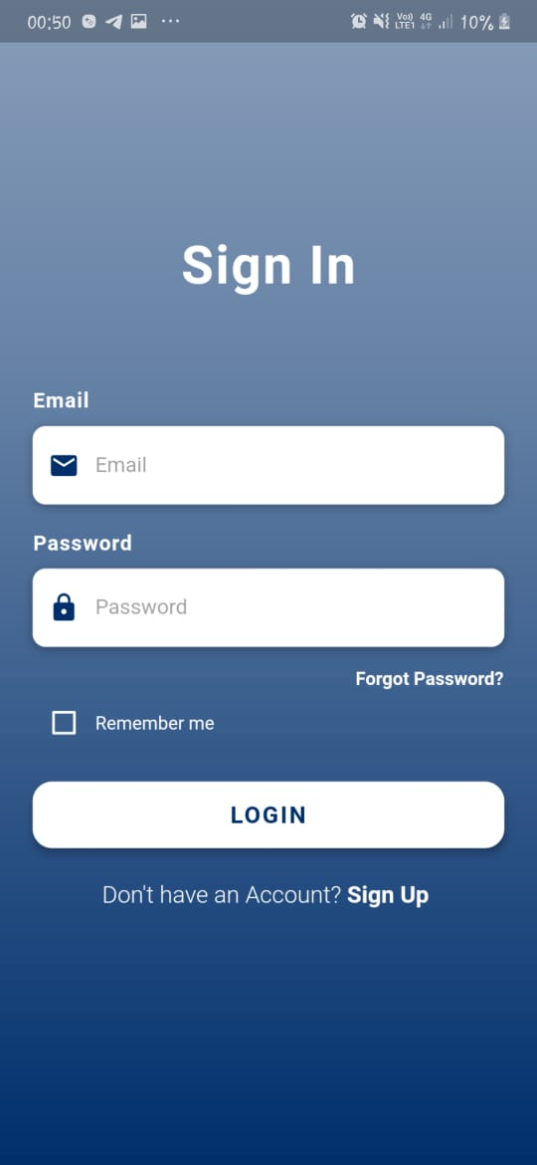
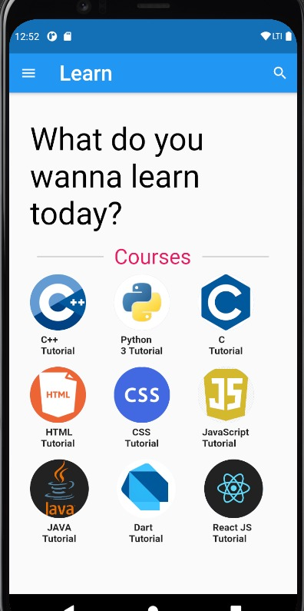
These screens show the student/administrator login page and the dashboard that is viewed by the student once logged in.

Slide 9
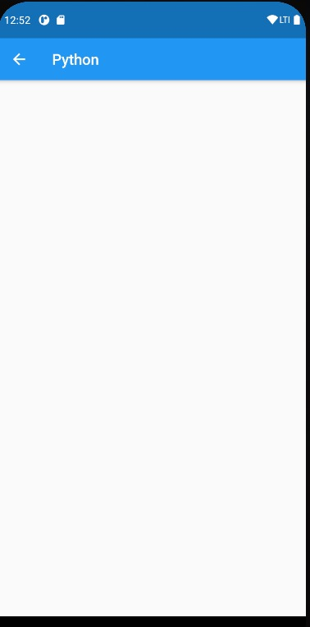
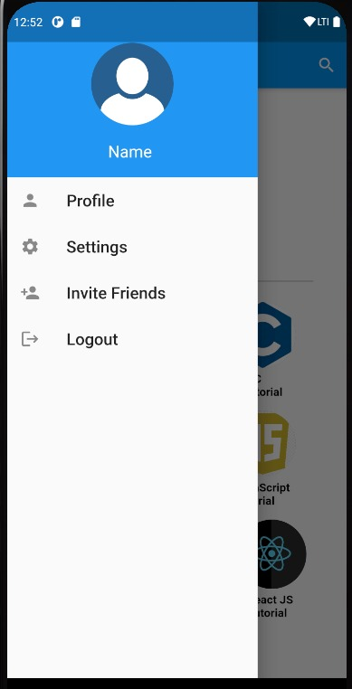
The student can then access each course separately where any due assignments or prerecorded videos uploaded by the faculty can be viewed.
There are many settings provided by which the student can sync their calendars to the app and receive daily updates and reminders on their device.

Slide 10
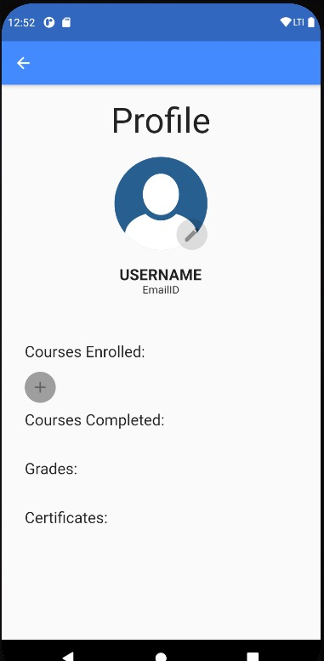
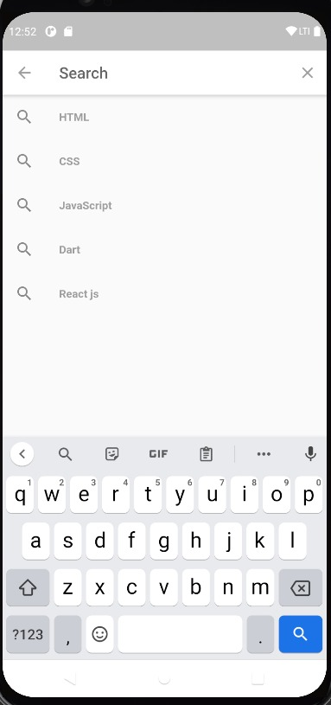
The student profile displays the courses enrolled and the courses completed, the corresponding grades received and certificates, if any, making it easier to monitor the students’ progress.
The student can also search for and avail any extra courses available, according to the credits earned.

Slide 11
Thank You
A project by Gol Guppa

